Slide 1
First Person Shooter Box Art Over Time
By: Chase Yates

Slide 2
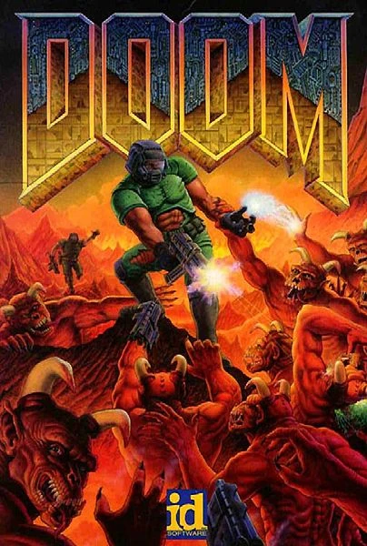
DOOM

Slide 3
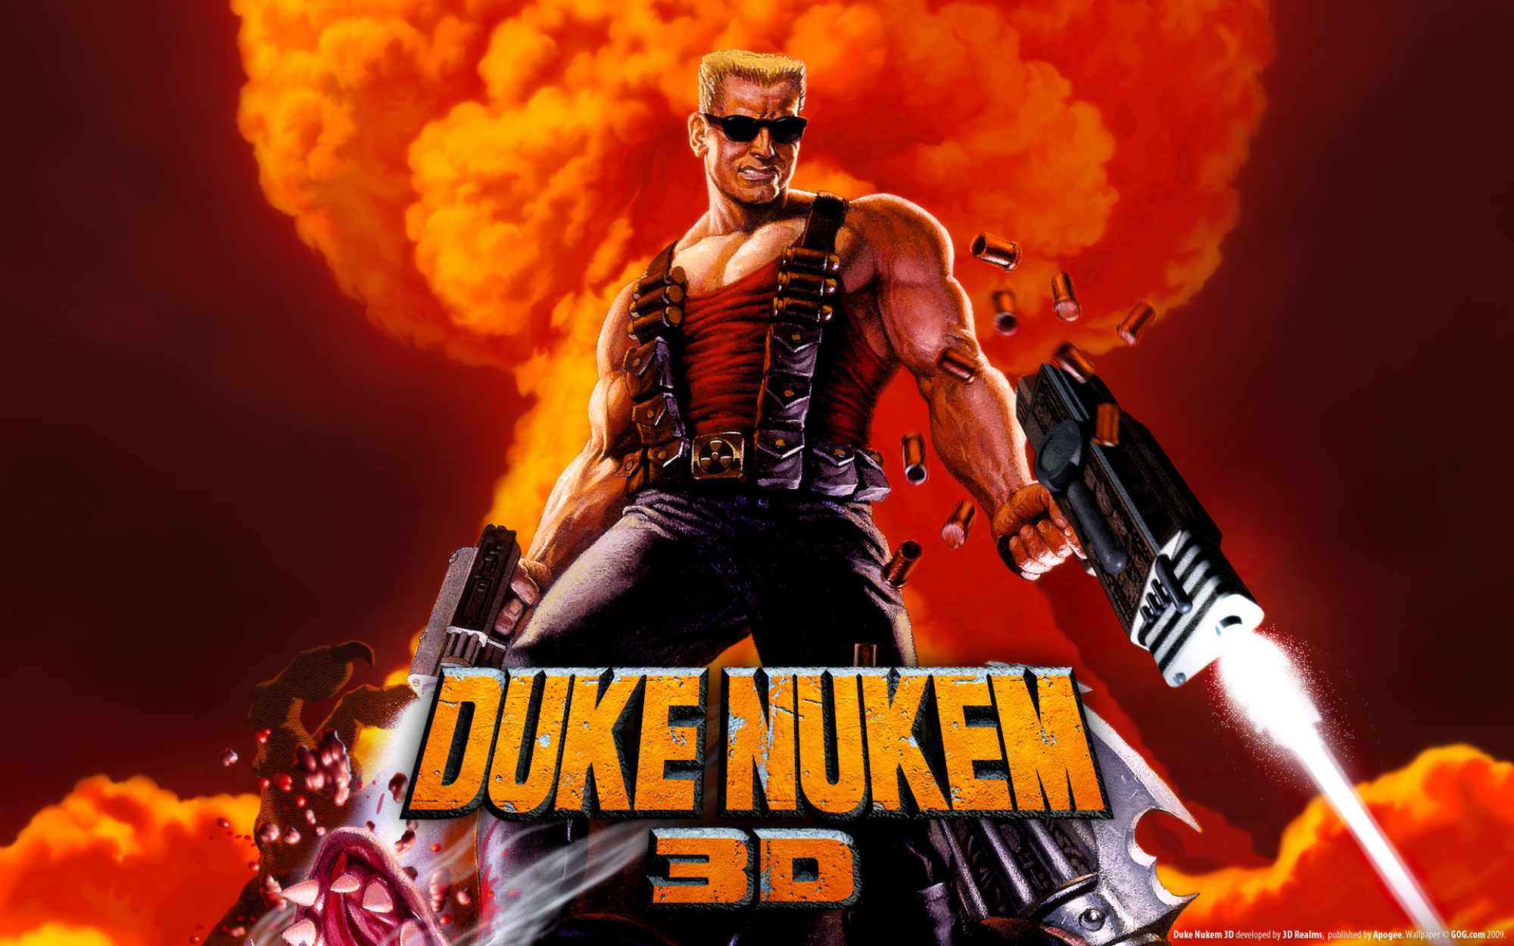
Duke Nukem 3D

Slide 4

Halo: Combat Evolved

Slide 5

Call of Duty 2

Slide 6

Battlefield 4

Slide 7

Rainbow Six Siege

Slide 8

Titanfall 2

Slide 9
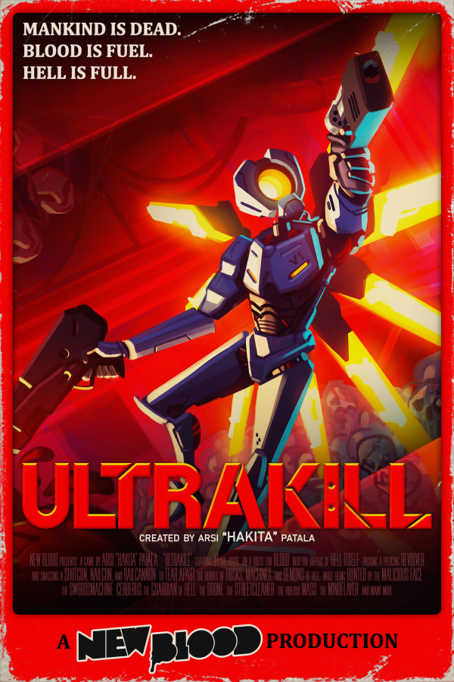
Ultrakill

